Slide 1
Streamflow conditions across North Carolina Assessment of hydrologic conditions observed through latter March 2011… USGS North Carolina Water Science Center http://nc.water.usgs.gov Online drought pages for USGS North Carolina WSC http://nc.water.usgs.gov/drought/
Presented to:
North Carolina Drought Management Advisory Council
Raleigh, NC
March 24, 2011

Slide 2
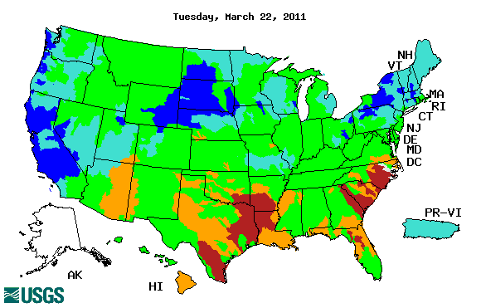
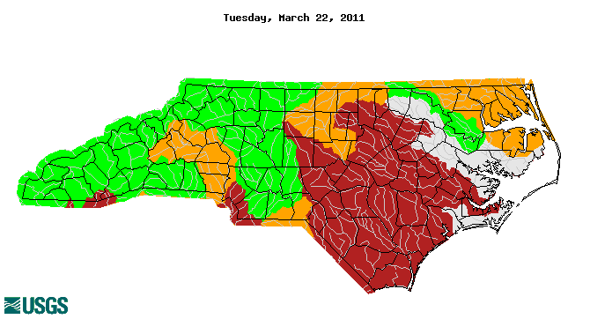
Overall 7-day average flows as of March 22
Available at URL http://waterwatch.usgs.gov/new/
2
Notes:
2

Slide 3
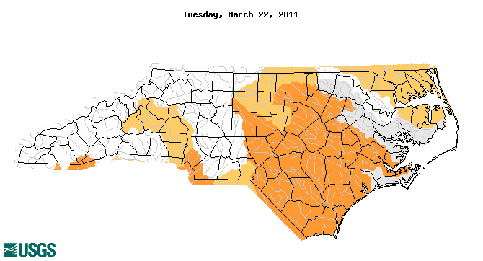
Below-normal 7-day average flows as of March 22
Available at URL http://water.usgs.gov/waterwatch/
3
Notes:
3

Slide 4
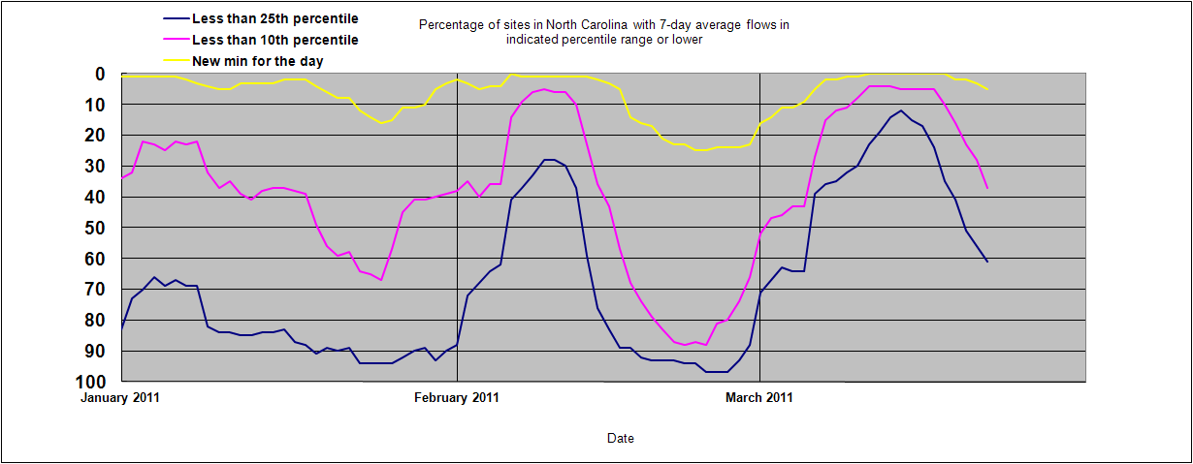
Percentage of sites with 7-day average flows below normal (< 25th percentile)
Since January 1, 2011
4
Notes:
4

Slide 5
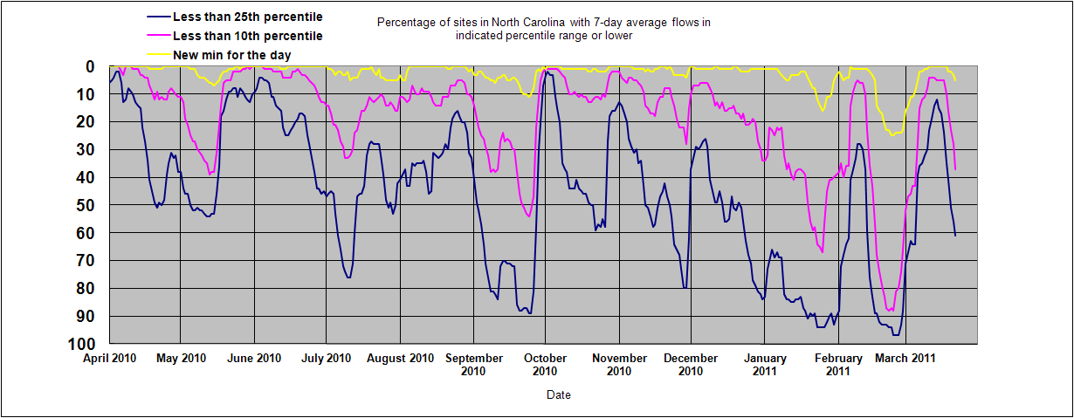
Percentage of sites with 7-day average flows below normal (< 25th percentile)
Since April 1, 2010
5
Notes:
5

Slide 6
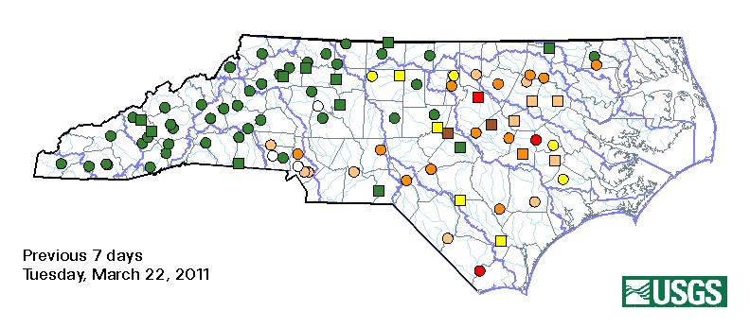
Median of percentiles for 7-day average flows during previous 7-day period through March 22
No – No drought D2 – Severe drought
D0 – Abnormally dry D3 – Extreme drought
D1 – Moderate drought D4 – Exceptional drought

Slide 7
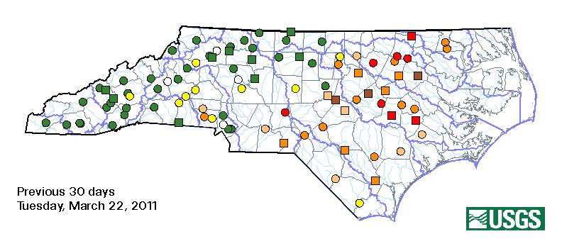
Median of percentiles for 7-day average flows during previous 30-day period through March 22
No – No drought D2 – Severe drought
D0 – Abnormally dry D3 – Extreme drought
D1 – Moderate drought D4 – Exceptional drought

Slide 8
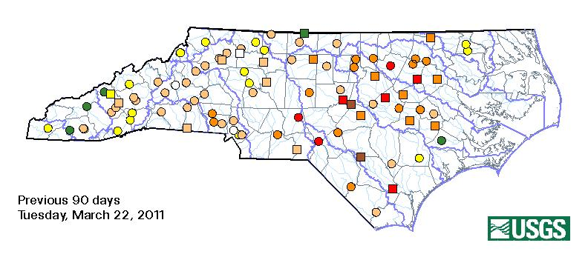
Median of percentiles for 7-day average flows during previous 90-day period through March 31
No – No drought D2 – Severe drought
D0 – Abnormally dry D3 – Extreme drought
D1 – Moderate drought D4 – Exceptional drought

Slide 9
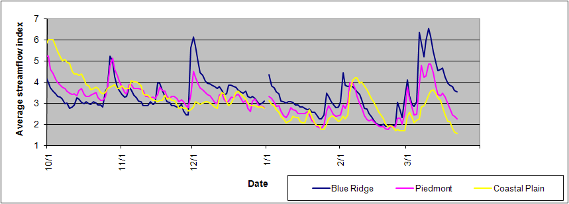
Average streamflow index (by Province)
New max
New max
90th percentile
Very wet
75th percentile
Wet
50th percentile
Normal
25th percentile
Dry
10th percentile
Very dry
New min
New min
9
Notes:
9
Average of streamflow index values for all sites by province during the period October 2010 through latter March 2011…

Slide 10
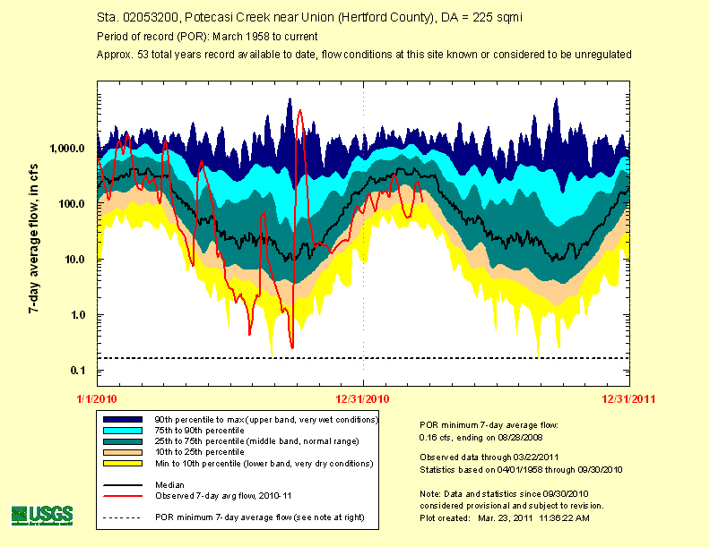

Slide 11
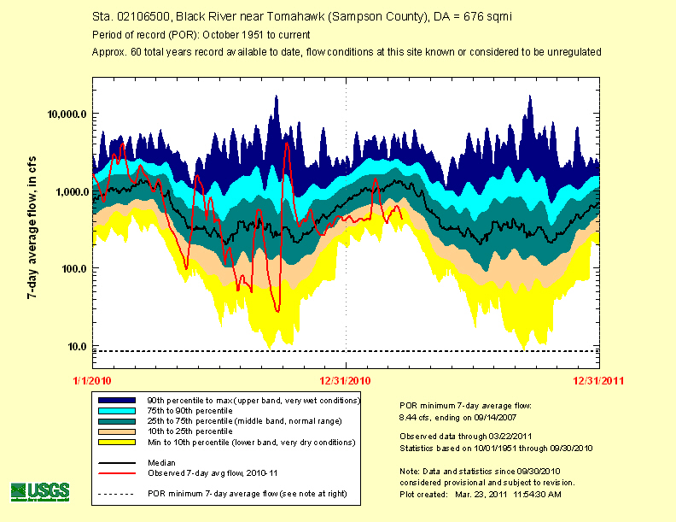

Slide 12
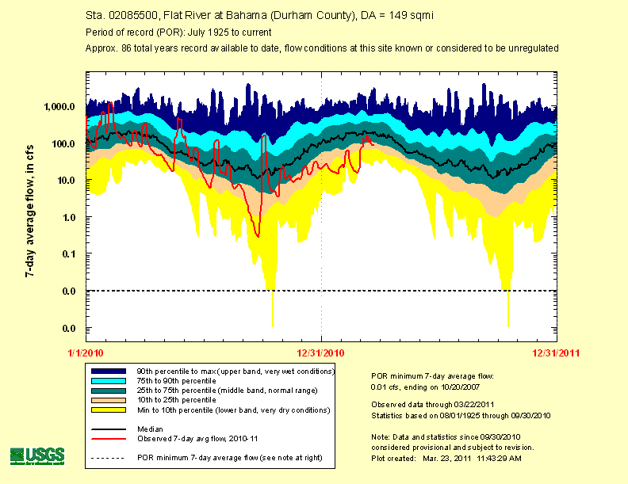

Slide 13
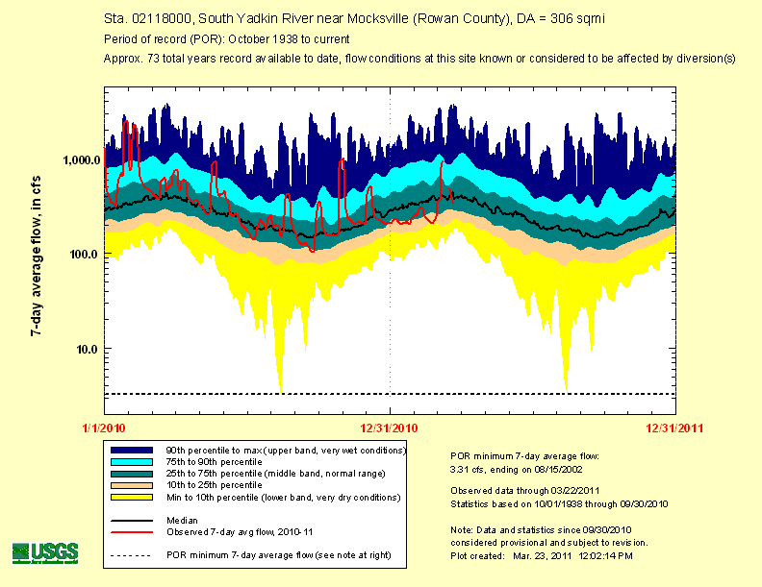

Slide 14
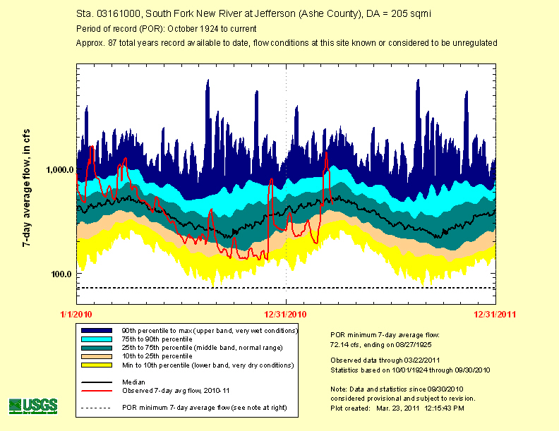

Slide 15
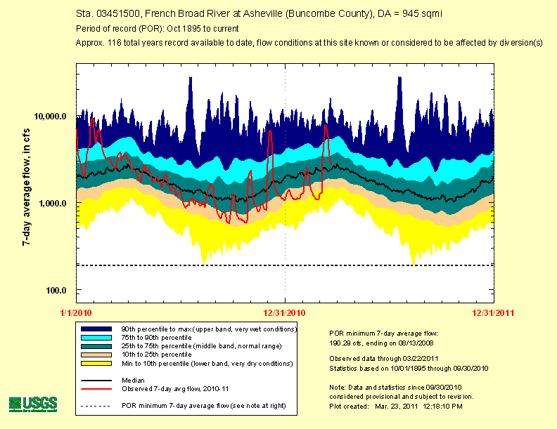

Slide 16
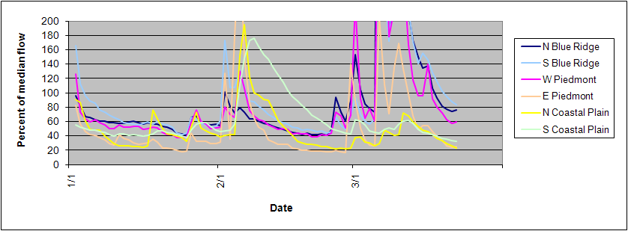
Percent of median (by region)
16
Notes:
16
Average of streamflow index values for all sites by province during the period January 2011 through latter March 2011…

Slide 17
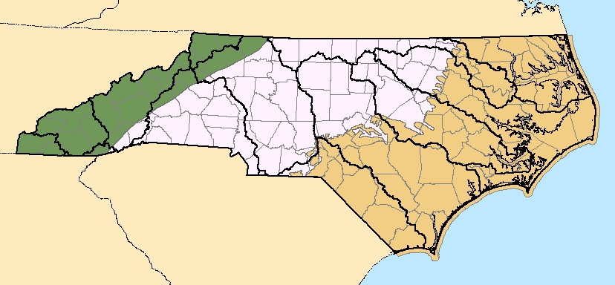
Typical ranges in percentage of median flow since January 1…(by region)
N Blue Ridge 55 to 80 %
E Piedmont 25 to 50 %
N Coastal Plain 30 to 50 %
W Piedmont 50 to 75 %
S Blue Ridge 55 to 100 %
S Coastal Plain 45 to 60 %
…as of March 23

Slide 18
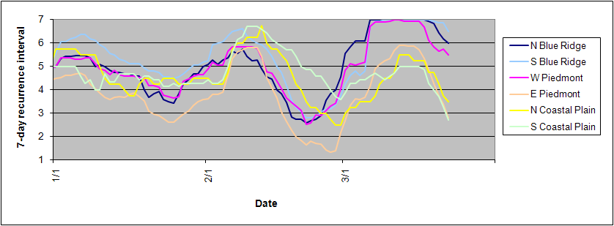
7-day average flow recurrence intervals (by region)
< 2 yrs
2 to 5 yrs
5 to10 yrs
10 to 20 yrs
20 to 50 yrs
50 to 100 yrs
> 100 yrs
In E Piedmont and N/S Coastal Plain regions… > up to 10 to 50+ -year RI on 7-day average flows
Notes:
Average 7-day recurrence intervals by region during the period January 2011 through latter March 2011…

Slide 19
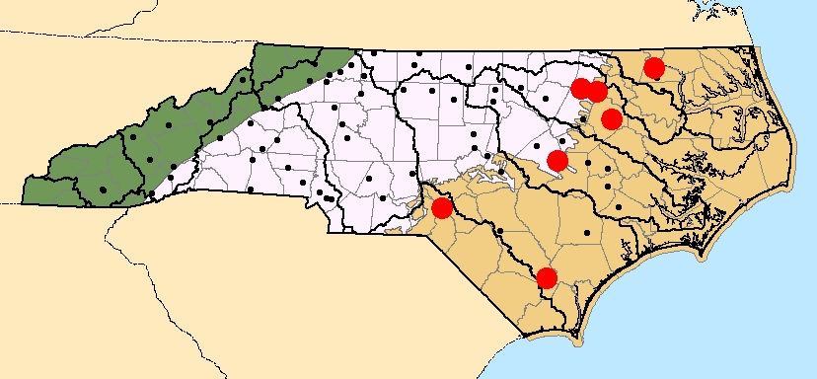
New record monthly minimum average during 2010 water year
7 sites in Coastal Plain…

Slide 20
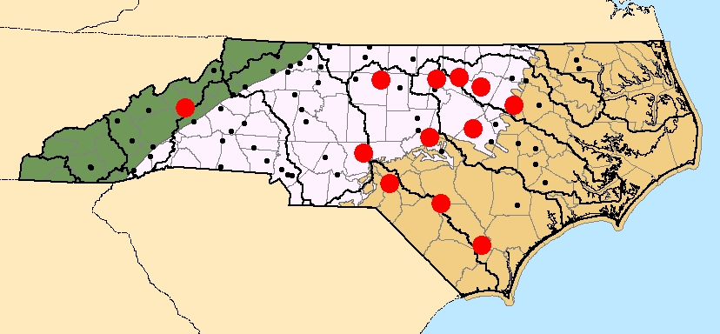
New record monthly minimum average during 2011 water year
12 sites…as of March 23

Slide 21
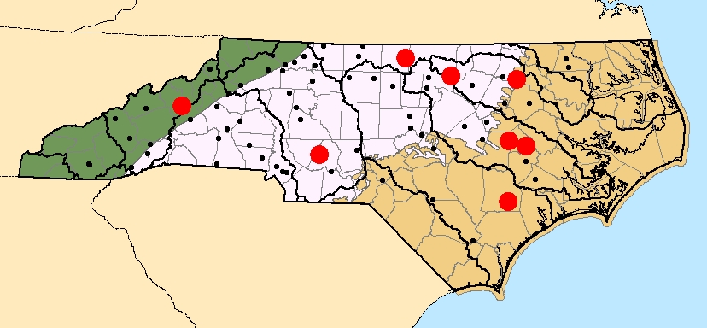
New period of record minimum daily mean discharge during 2010 water year
8 sites across state…

Slide 22
New period of record minimum daily mean discharge during 2011 water year
4 sites…as of March 23

Slide 23
Visualizing the components in streamflow
Overland
runoff
Base flow (ground-water discharge to streams)
From:
Ground-water-level Monitoring and the Importance of Long-Term Water-Level Data
USGS Circular 1217 by Taylor and Alley, 2002 (Figure A-2, page 4)

Slide 24
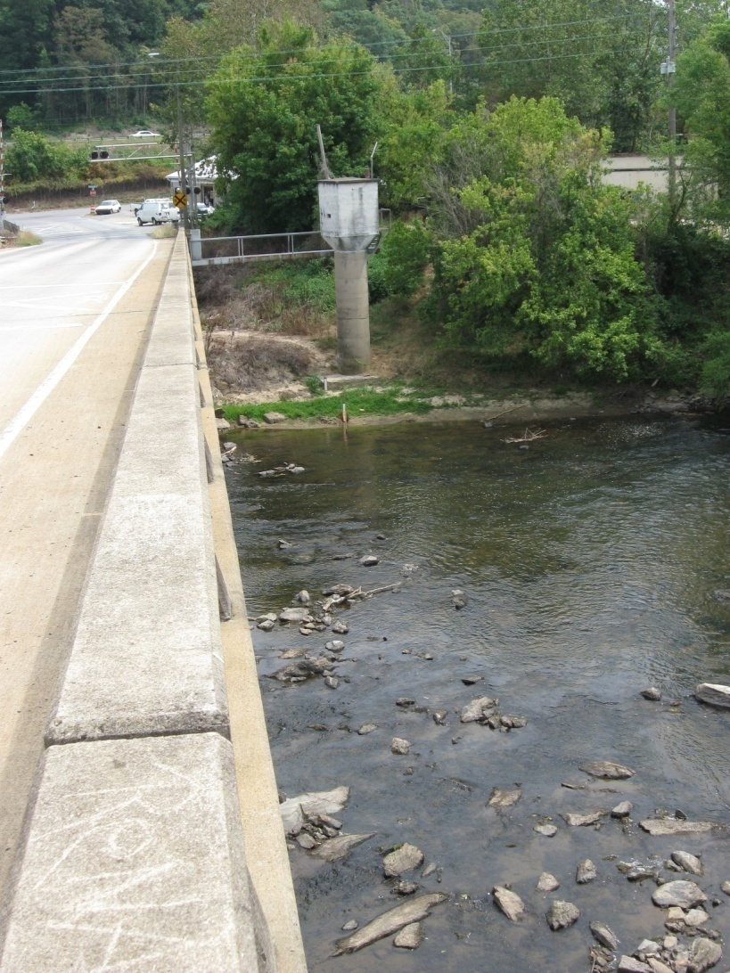
In closing…
Questions
Concerns
J. Curtis Weaver, Hydrologist USGS North Carolina Water Science Center jcweaver@usgs.gov (919) 571-4043
French Broad River at Asheville
Buncombe County
24

